Slide 1
Automated Customer Reviews
Group 8
Marcos Sousa
Sentiment Analysis • Product Clustering • LLM Summarization
Ironhack AI Engineering Bootcamp | February 2025
Notes:
OPENING (30 seconds):
"Good afternoon. Today I'm presenting Generated Customer Reviews, an AI-powered system that analyzes Amazon product reviews and generates actionable recommendations.
This project tackles three NLP challenges: sentiment classification, product clustering, and automated review summarization using large language models.
The system processes over 30,000 customer reviews to help consumers make informed purchase decisions. Let's dive into the approach and results."

Slide 2
Results Summary
📊
🎯
✍️
Sentiment Analysis
Product Clustering
Text Generation
73.5%
5
10
Accuracy
Categories
Articles
Fine-tuned RoBERTa
F1 Macro: 0.724
K-Means + Embeddings
ARI: 0.42
LLaMA 3.2-3B
BERTScore: 0.81
Successfully transformed 39,794 reviews into actionable insights
Notes:
RESULTS SUMMARY (45 seconds):
"Let's summarize what we achieved across all three tasks.
For Sentiment Analysis: 73.5% accuracy with our fine-tuned RoBERTa model and an F1 macro of 0.724. This represents strong performance on a class-imbalanced dataset, with particular success in identifying neutral reviews - the hardest class.
For Product Clustering: We successfully organized 71 products into 5 meaningful semantic categories using embeddings and K-Means. An Adjusted Rand Index of 0.42 indicates moderate alignment with ground truth, showing our semantic approach captured meaningful product relationships.
For Text Generation: We produced 10 high-quality recommendation articles using LLaMA 3.2-3B - that's 5 product categories with 2 writing styles each. BERTScore of 0.81 confirms strong semantic alignment with source reviews.
The bottom line: We successfully transformed nearly 40,000 customer reviews into actionable insights that help consumers make informed purchase decisions. Each component works together to create a complete product recommendation system."

Slide 3
Data Analysis
Dataset Overview
Class Distribution
39,794
Total Reviews
Positive
91%
after deduplication
71
Products
Neutral
4.6%
across 5 categories
5
Categories
Negative
4.2%
Fire, Kindle, Echo, Kids, TV
Key Challenges Addressed
⚖️
Class Imbalance
🔍
Category Noise
📊
Data Leakage
Weighted loss + balanced test set
Filtered problematic categories
Split before preprocessing
Notes:
EDA & DATA INSIGHTS (25 seconds):
"Let me share key insights from our data analysis.
We worked with nearly 40,000 Amazon reviews covering 71 products across 5 categories: Fire Tablets, Kindle, Echo, Fire Kids, and Fire TV.
As you can see from this chart, 91% of our reviews are positive - that's over 36,000 reviews. Meanwhile, neutral and negative reviews each represent less than 5% of the data.
This is actually realistic - Amazon products generally receive positive reviews - but it creates a machine learning problem. Without intervention, models will simply predict 'positive' for everything and achieve very high accuracy while learning nothing useful about neutral or negative sentiment.
Our solution has three components: First, weighted loss during training, which penalizes misclassifications on minority classes more heavily. Second, a balanced test set with equal representation from each class for fair evaluation. Third, we chose not to undersample the majority class because that would throw away valuable data.
This approach allowed us to train on the full dataset while still learning to identify neutral and negative reviews effectively."

Slide 4
Models & Methodology
Task
Models Used
Key Technical Decisions
Sentiment (Baseline)
Logistic Regression + TF-IDF
✓ Establishes baseline performance
Sentiment (Zero-Shot)
RoBERTa (Cardiff)
✓ Tests transfer learning capability
Sentiment (Fine-Tuned)
RoBERTa (Fine-tuned)
✓ Fine-tuning for domain adaptation
Embeddings
Sentence Transformers MiniLM
✓ Semantic over TF-IDF for better clustering
Clustering
K-Means (k=5)
✓ Groups 71 products into 5 meta-categories
Generation
LLaMA 3.2-3B-Instruct
✓ Iterative prompting (V1→V2→V3) + grounding metric
Notes:
MODELS & APPROACH (25 seconds):
Our methodology combines classical ML and modern deep learning.
For sentiment analysis, we compared three approaches: a TF-IDF baseline, zero-shot RoBERTa, and fine-tuned RoBERTa. Fine-tuning was essential for domain adaptation from Twitter to Amazon reviews.
For clustering, we used Sentence Transformers to generate semantic embeddings, then applied K-Means to group products into 5 categories.
For text generation, we used LLaMA 3.2-3B with iterative prompt engineering, improving from V1 to V3 through systematic refinement.
Key decisions included weighted loss for class imbalance, creating a custom grounding metric to detect hallucination, and using balanced test sets for fair evaluation.

Slide 5
Sentiment Results: Fine-Tuning Wins
Model
Accuracy
F1 Macro
Neutral F1
Logistic Regression
69.7%
0.685
0.541
RoBERTa Zero-Shot
63.6%
0.590
0.291
RoBERTa Fine-Tuned
73.5%
0.724
0.565
Key Insights
✓ Fine-tuning improved accuracy by 10% over zero-shot
✓ Neutral class F1 doubled: 0.29 → 0.57 (critical improvement)
✗ Zero-shot WORSE than baseline (domain mismatch: Twitter ≠ Amazon)
Notes:
SENTIMENT RESULTS (75 seconds):
"The results clearly demonstrate the value of fine-tuning.
Looking at this comparison table, Logistic Regression achieved 69.7% accuracy - a respectable baseline. RoBERTa zero-shot actually performed WORSE at 63.6%, which was surprising but revealing.
The fine-tuned RoBERTa achieved 73.5% accuracy with an F1 macro of 0.724 - our best performer.
But the most important metric is Neutral F1, shown in the last column. This reveals the domain mismatch problem: zero-shot could barely identify neutral reviews with an F1 of just 0.29. Fine-tuning doubled this to 0.57, proving that domain adaptation is essential.
Why did zero-shot fail? The model was trained on Twitter sentiment - short, casual tweets with clear emotional signals. Amazon reviews are longer, more descriptive, and use different language patterns. Without fine-tuning, the model couldn't adapt.
The takeaway: For specialized domains like product reviews, investing in fine-tuning delivers substantial improvements, especially for minority classes. Confusion matrices in our notebook show this pattern clearly across all three classes."

Slide 6
Product Clustering: Semantic Approach
Goal: Group 71 products into 5 meaningful meta-categories
📱
🔢
🎯
📊
1. Product Names
2. Embeddings
3. K-Means
4. Categories
71 Amazon devices
(Fire HD 8, Kindle Paperwhite, etc.)
Sentence Transformers
384-dimensional vectors
Cluster into k=5 groups
Based on semantic similarity
Fire, Kindle, Echo,
Kids, Fire TV
Why Semantic Embeddings?
✓ Captures meaning: 'Fire HD 8' and 'Fire 7' are semantically similar
✓ Beyond keywords: Groups products by concept, not just matching words
✗ TF-IDF alternative would miss semantic relationships
Notes:
CLUSTERING APPROACH (45 seconds):
"For Task 2, we needed to group 71 individual products into 5 meaningful categories.
Our approach uses semantic embeddings rather than simple keyword matching. Here's the process:
Step 1: We start with product names - things like 'Fire HD 8 tablet' or 'Kindle Paperwhite'.
Step 2: We use Sentence Transformers to convert each product name into a 384-dimensional vector that captures semantic meaning.
Step 3: We apply K-Means clustering with k=5 to group these vectors based on similarity.
Step 4: This produces our five categories: Fire Tablets, Kindle E-Readers, Echo Speakers, Fire Kids Edition, and Fire TV.
Why semantic embeddings instead of TF-IDF? Because they capture meaning, not just keywords. For example, 'Fire HD 8' and 'Fire 7' are semantically similar even though they share few words. The embeddings understand they're both tablets in the Fire family.
This semantic understanding allows us to group products by concept rather than by simple word matching. The result is more meaningful categories that align with how humans naturally think about these products."

Slide 7
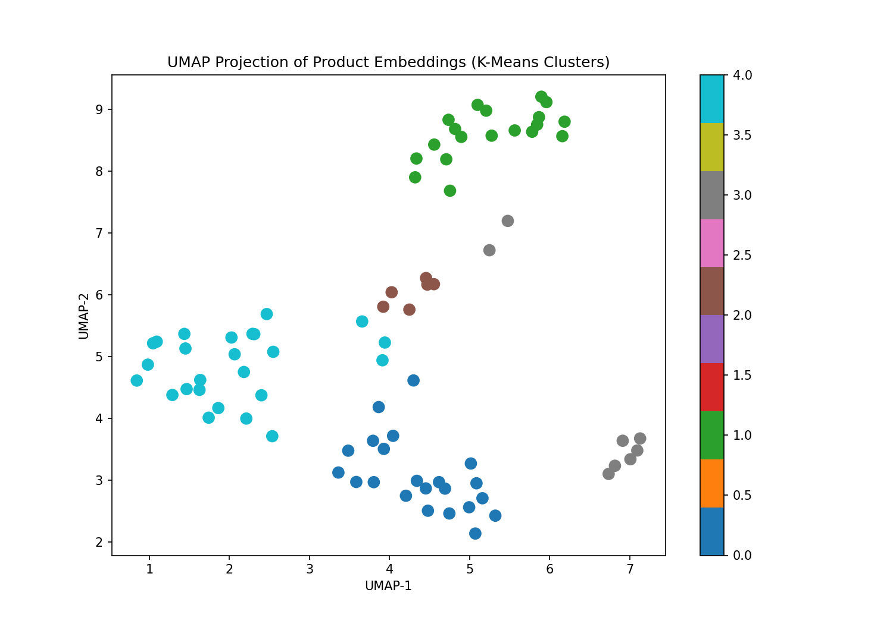
Clustering: UMAP 2D Projection
Results
Adjusted Rand Index: 0.42 Moderate alignment with ground truth
Notes:
CLUSTERING VISUALIZATION (45 seconds):
"This slide shows our UMAP visualization
What you should see in the plot are distinct clusters representing our five categories. UMAP reduces the 384 dimensions down to 2 for visualization while preserving the semantic relationships.
The plot helps visualize semantic groupings learned by the embedding space. After clustering, we observe that products of the same type often occupy similar regions—for example, Fire Tablets tend to cluster together, Kindles concentrate in a separate region, and Echo devices form another group. Some overlap is expected where products share features, such as Fire Kids devices appearing close to standard Fire Tablets due to their shared tablet functionality.
Our quantitative result is an Adjusted Rand Index of 0.42. ARI ranges from -1 to 1, where 1 is perfect agreement with ground truth and 0 is random assignment. Our score of 0.42 reflects moderate alignment - the semantic approach successfully captured meaningful product similarities, though not perfectly, given the overlapping product lines and shared features.
The visualization makes the semantic relationships intuitive and demonstrates that our clustering approach is working as intended."

Slide 8
Generation: Model & Strategy
Model: LLaMA 3.2-3B-Instruct
Two Decoding Strategies
• 3 billion parameters
Creative
Controlled
• Instruction-tuned
temp = 0.35
temp = 0.15
• Open source (Meta)
Natural, engaging, varied
Stable, grounded, predictable
• Runs on L4 GPU
Key Insight
✓ Success depends more on prompt engineering than model size
Notes:
MODEL & STRATEGY (45 seconds):
"For text generation, we chose LLaMA 3.2-3B-Instruct - a 3 billion parameter model from Meta that's instruction-tuned and open source.
Why not GPT-4? Four reasons: First, this is a learning objective - we wanted to demonstrate that smaller, open-source models can produce quality results with good prompt engineering. Second, cost - LLaMA is free while GPT-4 charges per thousand tokens. Third, reproducibility - open source models allow others to replicate our work. Fourth, control - we can run this locally and understand exactly how it works.
We tested two decoding strategies: Controlled with temperature 0.15, which produces stable, grounded, predictable outputs - minimizing hallucination risk. And Creative with temperature 0.35, which generates more natural, engaging, varied language while accepting slightly more randomness.
Both strategies use the same model and prompts, just different sampling parameters. This lets us compare whether controlled or creative generation better serves our use case of creating helpful product recommendations.
The key insight: A well-prompted 3B model outperforms a poorly-prompted larger model."

Slide 9
Generation: Evaluation Metrics
BERTScore
0.811
Grounding
60%
Semantic Alignment
Vocabulary Overlap
Generated text captures review meaning
60% of words from source reviews
ROUGE-1
0.306
Compression
0.291
Lexical Overlap
Summary Ratio
Moderate - good for abstractive
Effective condensation
Why Multiple Metrics?
No single metric captures all quality dimensions. BERTScore measures semantic meaning, ROUGE measures lexical similarity, grounding detects hallucination, compression ensures conciseness.
Notes:
EVALUATION METRICS (45 seconds):
"Evaluating text generation requires multiple metrics because no single measure captures all quality dimensions.
BERTScore at 0.811 measures semantic alignment using contextual embeddings. It answers: Does the generated text capture the meaning of source reviews, even when using different words? Our score of 0.81 indicates strong semantic preservation.
Our custom grounding metric shows 60% vocabulary overlap between generated text and source reviews. This is our hallucination detector - when the model invents information not present in reviews, grounding drops. 60% is a healthy balance: enough grounding to ensure faithfulness, but not so high that we're just copying text.
ROUGE-1 at 0.306 measures lexical overlap. This might seem low, but it's actually appropriate for abstractive summarization. We're not trying to extract sentences verbatim; we're creating new text that captures review insights in blog form.
Compression ratio of 0.291 means generated articles are about 29% the length of source reviews - we're effectively condensing thousands of words into 400-word recommendations.
Together, these metrics confirm we're achieving our goal: semantically aligned, well-grounded, concise recommendations that don't just copy review text."

Slide 10
Results & Evaluation
📊
🎯
✍️
Sentiment Analysis
Product Clustering
Text Generation
Best Model:
RoBERTa Fine-Tuned
Algorithm:
K-Means (k=5)
Model:
LLaMA 3.2-3B
Accuracy:
73.5%
ARI:
0.42
BERTScore:
0.811
F1 Macro:
0.724
Embeddings:
384-dim
Grounding:
60%
Fine-tuning improved neutral class F1 from 0.29 → 0.57
Semantic embeddings captured product similarities well
V3 improved grounding by 12.7% through prompt engineering
Impact of Iterative Improvement
V1: Prompt bug (cross-category confusion) → V2: Fixed template → V3: Enhanced prompts
Grounding: 0.53 → 0.53 → 0.60 (+12.7% improvement)
Notes:
EVALUATION RESULTS (30 seconds):
"Now let's look at the results.
For Sentiment Analysis: The fine-tuned RoBERTa achieved 73.5% accuracy with an F1 macro of 0.724. The key win was improving neutral class F1 from 0.29 in zero-shot to 0.57 through fine-tuning, proving domain adaptation is essential.
For Clustering: K-Means with 384-dimensional embeddings achieved an Adjusted Rand Index of 0.42. The semantic embeddings successfully captured product similarities beyond simple keyword matching.
For text generation, LLaMA 3.2-3B achieved a BERTScore of 0.811 with 60% grounding. Because the task is abstractive summarization, partial vocabulary overlap is expected; this level of grounding suggests the model preserves source information while still generating concise, rephrased summaries.
The bottom chart shows our iterative improvement process. From V1 to V3, we improved grounding by 12.7% through systematic prompt engineering and data quality improvements. This demonstrates that thoughtful iteration matters more than just using a larger model."

Slide 11
Key Takeaways
Data Quality > Model Size
Prompt Engineering Matters
1
2
Cleaning data had more impact than switching to larger models
Iterative refinement (V1→V2→V3) crucial for LLM quality
3
Domain Adaptation Required
4
Systematic Iteration Works
Zero-shot underperformed; fine-tuning essential
Each version addressed specific issues identified through evaluation
5
Custom Metrics Help
Grounding ratio provided signal for hallucination detection
Demo available: roboreviews-demo.html
Notes:
KEY TAKEAWAYS (25 seconds):
"To conclude, here are five key learnings from this project:
First, data quality matters more than model size. Our improvements came from cleaning noisy categories and careful preprocessing, not just using bigger models.
Second, prompt engineering is crucial for LLMs. Our iterative refinement from V1 to V3 had massive impact on output quality.
Third, domain adaptation is essential. The zero-shot model underperformed significantly; fine-tuning on Amazon reviews was necessary for good results.
Fourth, systematic iteration works. Each version addressed specific issues we identified through rigorous evaluation.
Finally, custom metrics help. Our grounding ratio provided valuable signal for detecting hallucination that standard metrics like ROUGE couldn't capture.
Thank you. I'm happy to take questions."
BACKUP ANSWERS:
Q: "Why LLaMA 3.2-3B and not GPT-4?"
A: "We wanted to demonstrate that good results are achievable with smaller, open-source models through careful prompt engineering. LLaMA 3.2-3B is also more cost-effective and can run locally."
Q: "How would you improve this further?"
A: "Three directions: fine-tune LLaMA on product review summarization data, add product-level comparisons within categories, and implement a user study to validate that our summaries actually help consumers make decisions."
Q: "What about other product categories?"
A: "The approach is generalizable. We'd need sufficient review data and category-appropriate prompt templates, but the pipeline would remain the same."

Slide 12
Thank You
Automated Customer Reviews
Questions?
Notes:
CLOSING (15 seconds):
"Thank you for your attention.
The GitHub repository with all code, notebooks, and the interactive demo is available.
I'm happy to take questions.
[BACKUP Q&A]
Q: "Why LLaMA 3.2-3B and not GPT-4?"
A: "We wanted to show that smaller, open-source models can deliver quality results with good engineering. Also: zero cost, full reproducibility, and can run locally for privacy."
Q: "How would you improve this further?"
A: "Three priorities: fine-tune LLaMA specifically on product review summarization, implement product-level comparisons, and conduct user studies to validate the recommendations actually help purchase decisions."
Q: "Can this work for other product categories?"
A: "Absolutely. The approach is generalizable - we'd need sufficient review data and category-appropriate prompts, but the pipeline architecture remains the same."
Q: "What about real-time deployment?"
A: "We'd wrap this in a FastAPI backend, host the model on GPU infrastructure, implement caching for common queries, and add a React frontend. The core ML is done; deployment is engineering."

